Slide 1
JAWAHARLAL NEHRU UNIVERSITY School of Computer And System Sciences PROJECT PRESENTATION
Subject – Natural Language Processing
Submitted by – Isha Raj (21/10/JC/051)
Himani Saini(21/10/JC/001)
Submitted to – Dr. Piyush Pratap Singh

Slide 2

Project Topic – Text-to-Speech And Speech-to-Text in Any Language.

Slide 3
Introduction
Text-to-Speech is a type of assistive technology that reads digital text aloud. It is a web application that allows multiple users to talk and collaborate to each other.
Speech-to-Text is an application that enables the recognition and translation of spoken language into text through computation linguistic.

Slide 4
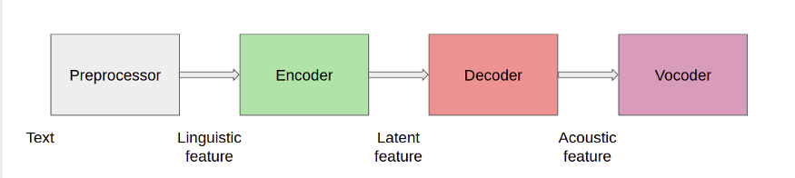

How Text-to-Speech Works
The input is text, which passes through several blocks and eventually is converted to audio.
PREPROCESSOR -
Tokenize: Tokenize a sentence into words
Phonemes/Pronunciation: It breaks input text into phonemes, based on their pronunciation. For example, “Hello, Have a good day” converts to HH AH0 L OW1, HH AE1 V AH0 G UH1 D D EY1.
Phoneme duration: Represents the total time taken by each phoneme in the audio.
Pitch: Key feature to convey emotions, it greatly affects the speech prosody.

Slide 5
Encoder
The encoder inputs Linguistic features (Phonemes) and outputs an n-dimensional embedding. This embedding between the encoder and decoder is known as the latent feature.
Decoder
The decoder is used to convert information embedded in the Latent processed feature to the Acoustic feature.
Vocoder
It converts the Acoustic feature (Mel-spectrogram) to waveform output (audio). It can be done using a mathematical model.

Slide 6
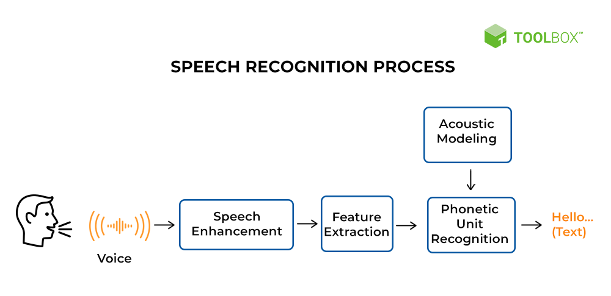
How Speech-to-Text Works
The Speech recognition Software breaks the speech down into bits it can interpret, converts it into a digital format, and analyzes the pieces of content.
Speech enhancement aims to improve speech quality by using various algorithms.
Feature extraction refers to the process of transforming raw data into numerical features.
It is the distinct units of sound in spoken English that distinguish one word from another.
An acoustic model is used in automatic speech recognition to represent the relationship between an audio signal and the phonemes.

Slide 7
Libraries
Tkinter – For GUI
gtts -
googletrans
playsound
os

Slide 8
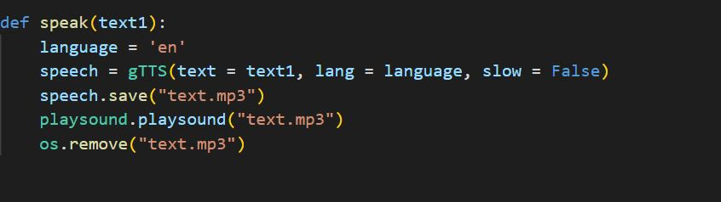
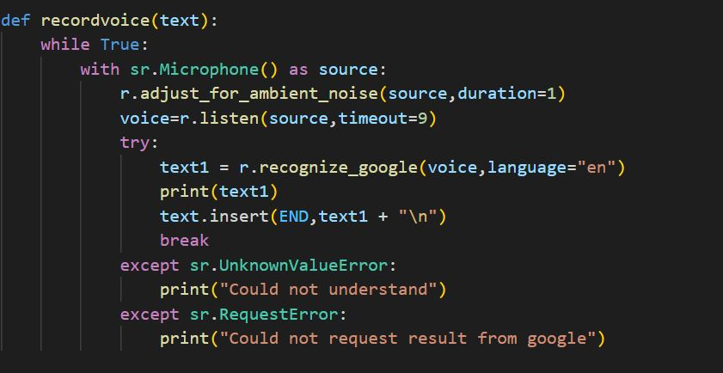
Speak() and recordvoice()

Slide 9
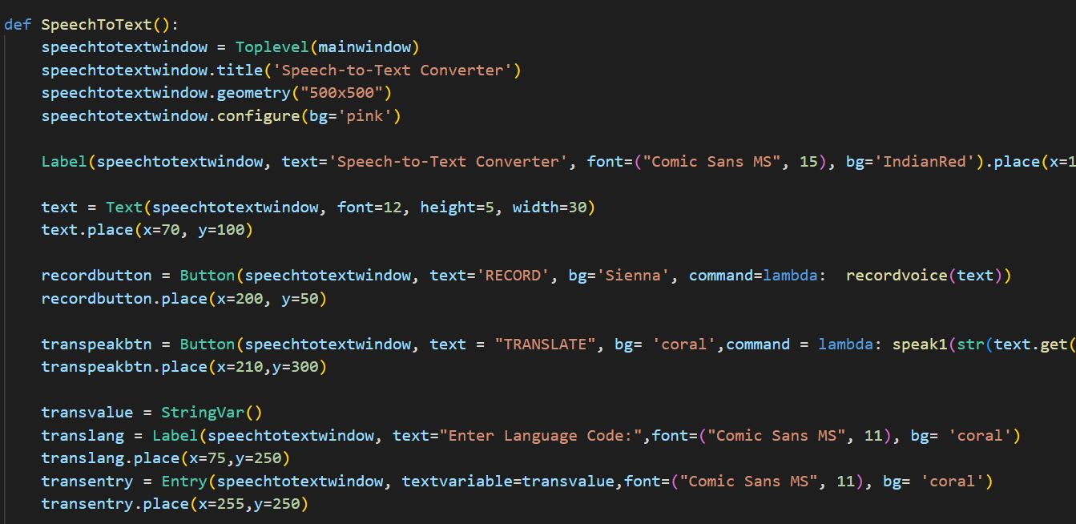
SpeechToText() Function

Slide 10
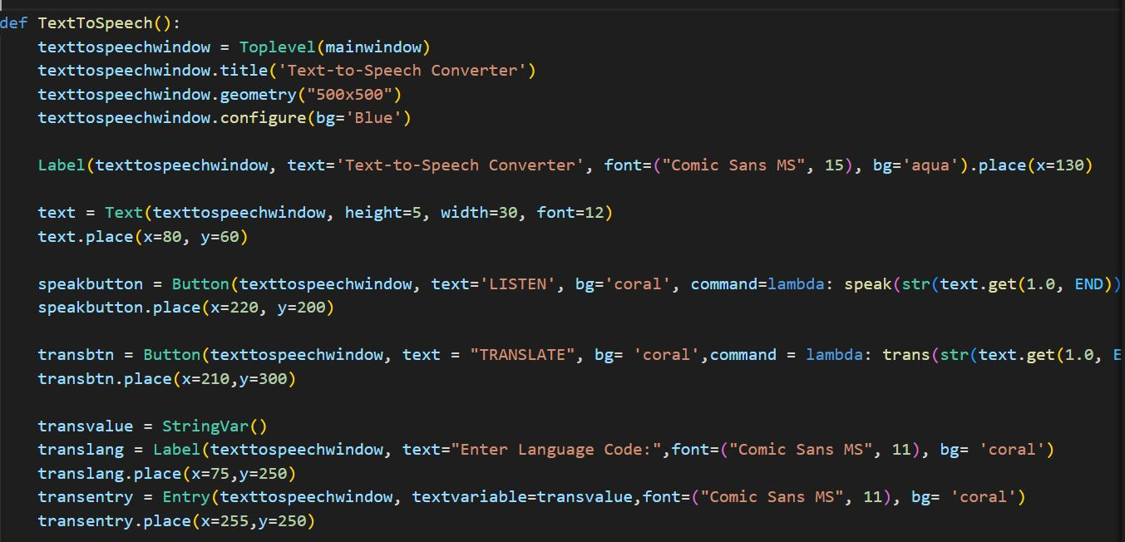
TextToSpeech() Function

Slide 11
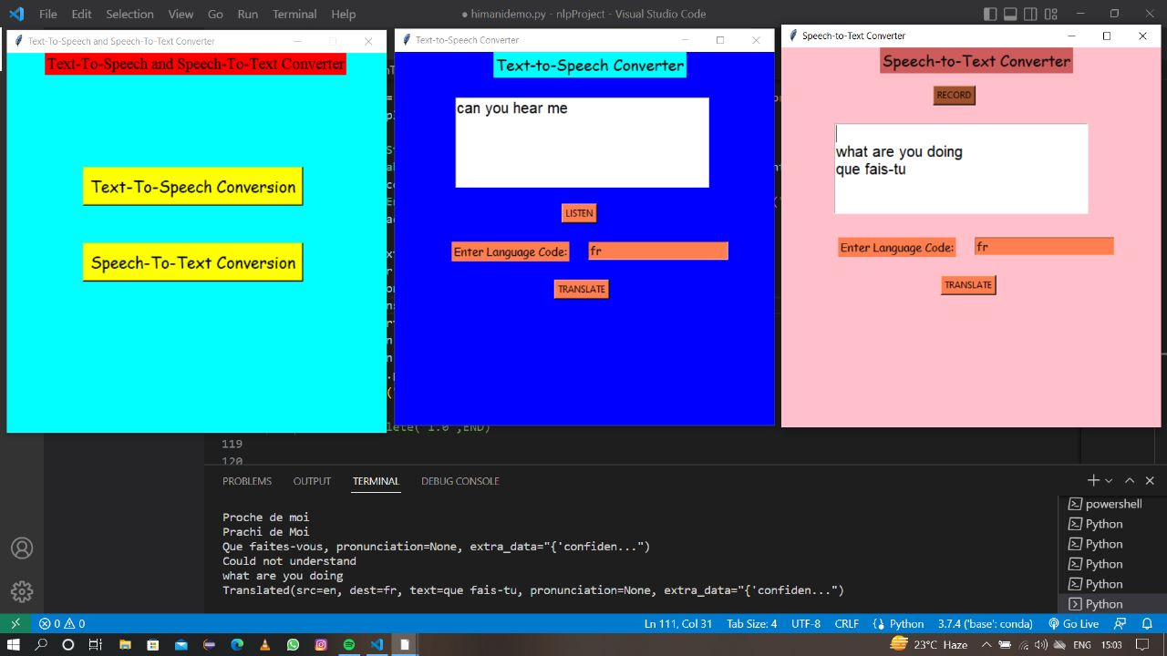
Screenshots

Slide 12
Thank you

